Slide 1
Introduction to React Native
Nader Dabit
Developer Advocate, AWS Mobile

Slide 2

What is React Native?
Built using React
Build cross platform applications using JavaScript
Target not only iOS & Android, but also Apple TV, VR, AR, Windows, & Desktop
Released March 2015
Rapidly gaining in popularity & adoption
Learn once write anywhere
Real world projects typically see 80% – 95% code reuse

Slide 3
Who’s using React Native
Facebook
Instagram
Walmart
Salesforce
Amazon
Skype
Baidu
American Express
Tesla
Adidas
Discord
Wix
Bloomberg
Visa
Microsoft
JD.com (266 million active users)

Slide 4
Why React Native
Faster speed of development
Lower cost of development
Code reuse
Easier to find developers
Ship across multiple platforms
Possible to ship over the air updates bypassing App Store / Play Store

Slide 5
How does React Native Work?
Write your application in JavaScript
JavaScript is transpiled & minified
Separate threads for UI, layout, and JavaScript
Threads communicate asynchronously through the native bridge

Slide 6
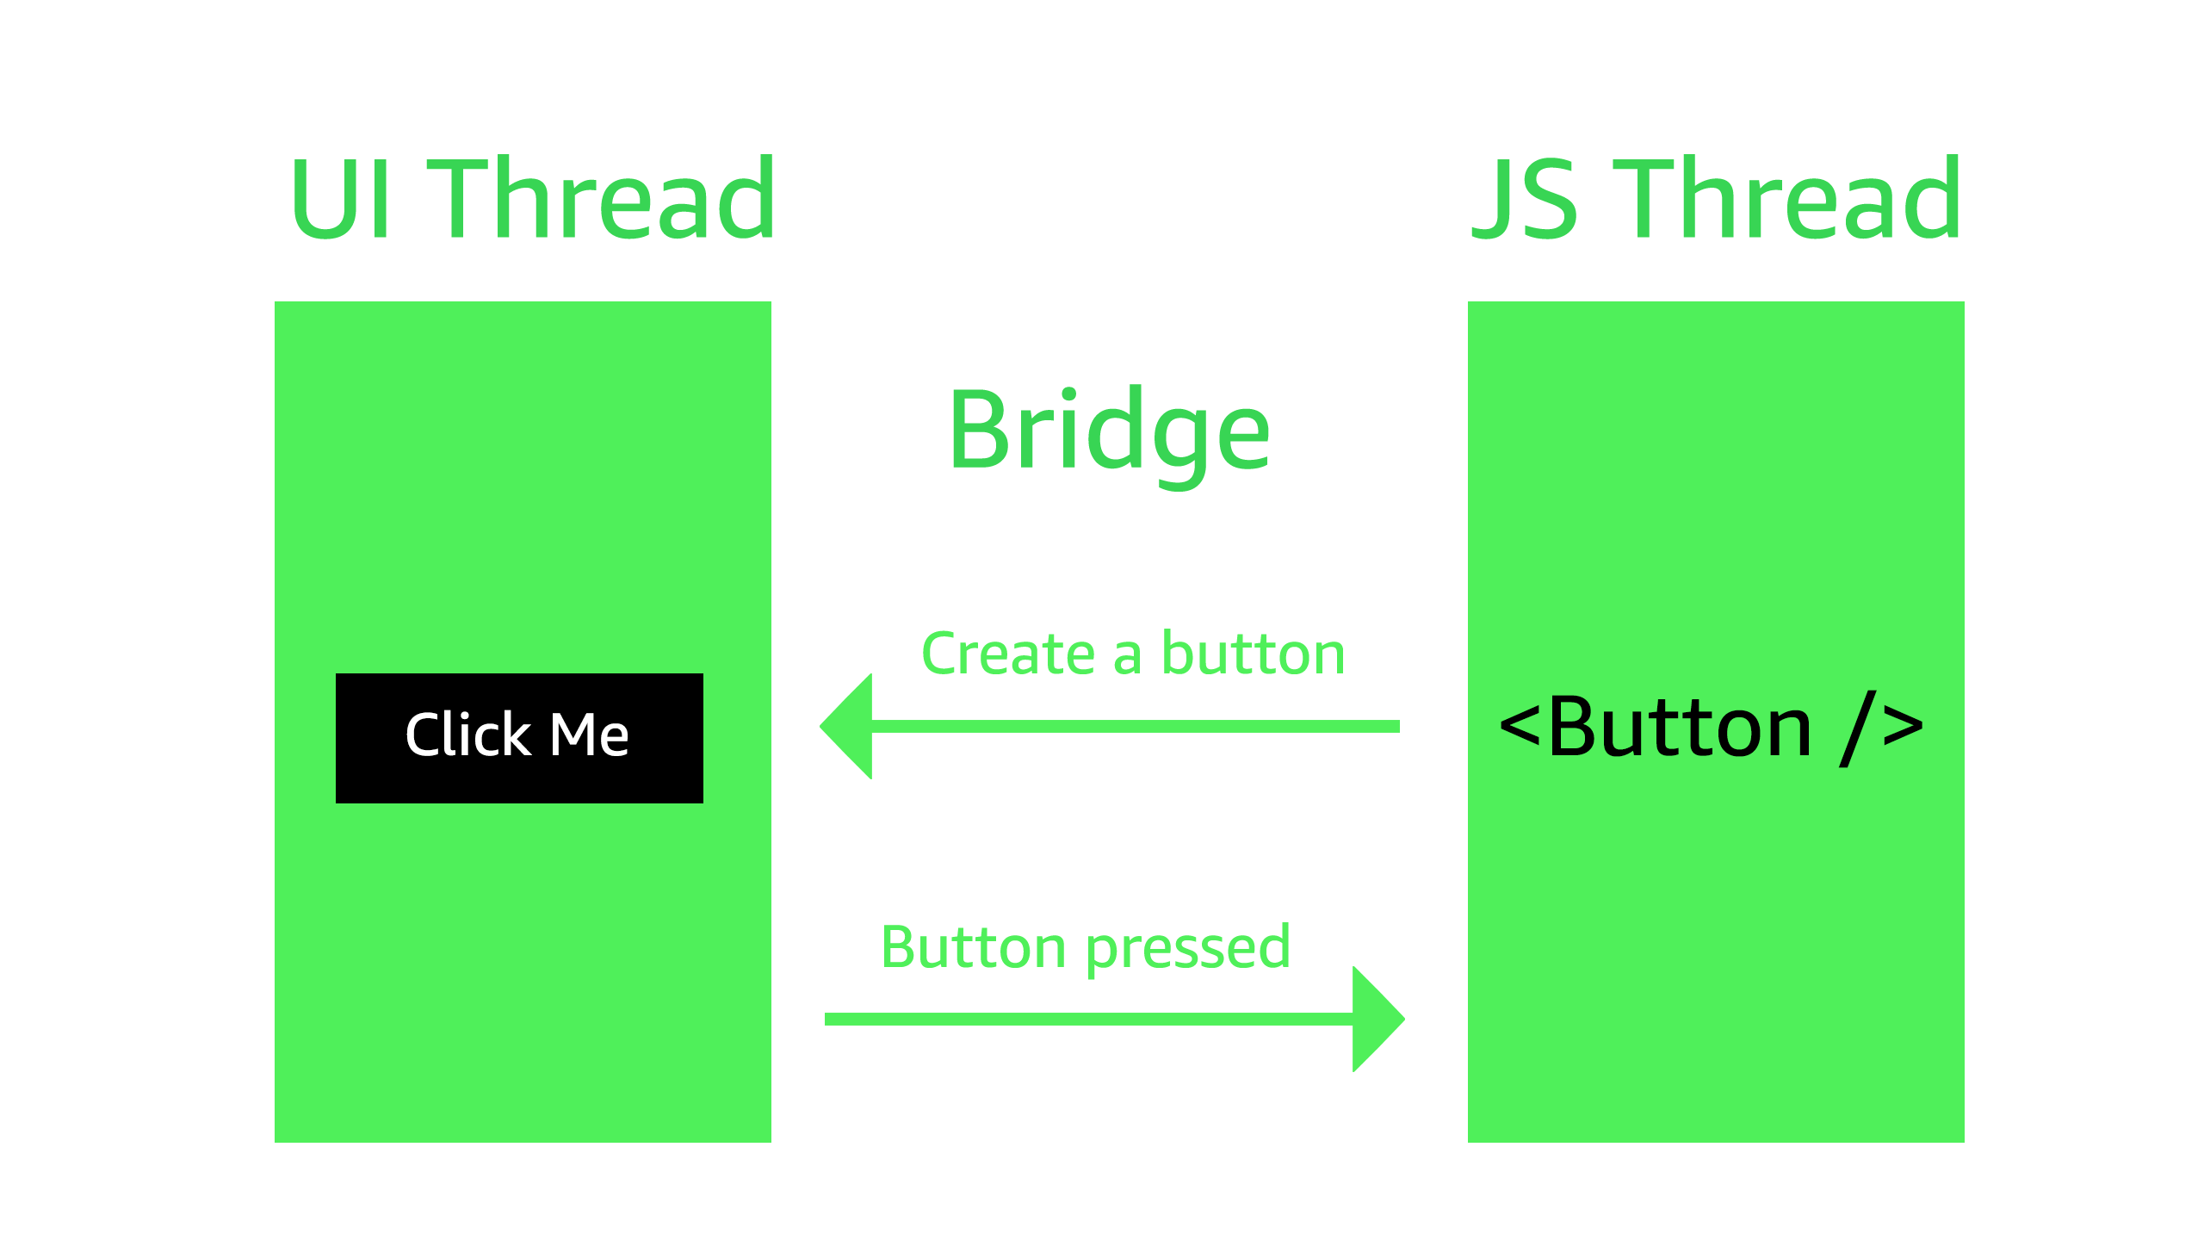
How does React Native Work?

Slide 7
React Native API
Over 30 UI Primitives
View
Text
ScrollView
Image
TextInput
Switch

Slide 8
React Native API
Mapping to Web UI primitives
View == div
Text == span / p / h*
ScrollView == div + styling
Image == img
TextInput == input

Slide 9
React Native API - Components
Primitives not globally in scope, must be imported
import {
View
Text
ScrollView
Image
TextInput
Switch
} from ‘react-native’

Slide 10
React Native API – Device APIs
Device APIs
CameraRoll
Keyboard
NetInfo
Vibration
PanResponder

Slide 11
React Native vs Web

Slide 12
React Native vs Web
Different primitives
Styling
Most browser APIs do not exist
Some browser APIs polyfilled (geolocation, fetch, timers, console)
Navigation
Mobile UI / UX
Native IDEs / configuration
Deployment

Slide 13
React Native vs Web
Event handling
Unlike web, not every component has every interaction
Handful of “touchable” components
Button, TouchableHighlight, TouchableOpacity, TouchableWithoutFeedback
Create custom touchable components with PanResponder API

Slide 14
React Native vs Web
Styling
Based on CSS styles
Layout is done with FlexBox
Style prop can be one style or an array of styles
Styles can be created & updated dynamically
Use StyleSheet API for perf optimization

Slide 15
React Native vs Web
Styling
Inline styles
<View
style={{
margin: 20,
backgroundColor: ‘red’
}}
/>

Slide 16
React Native vs Web
Styling
JS Objects
const styles = {
container: {
margin: 20,
backgroundColor: ‘red’
}
}
<View
style={styles.container}
/>

Slide 17
React Native vs Web
Styling - StyleSheet
import { StyleSheet } from ‘react-native’
const styles = StyleSheet.create({
container: {
margin: 20,
backgroundColor: ‘red’
}
})
<View style={styles.container} />

Slide 18
React Native vs Web
Styling – Array of styles
<View style={[styles.container, styles.blueBG]} />

Slide 19
Creating a new React Native Project
2 Main Options
React Native CLI
Create React Native App CLI

Slide 20
Creating a new React Native Project
Create React Native App CLI
Builds without native projects & code
Native code not configurable
Will run without all SDKs & IDEs installed
Great for newer developers
Includes features like Camera, Location, Push Notifications, Social Authentication, Accelerometer, File System, & Image Picker configured out of the box
Can eject into a native project at any time

Slide 21
Creating a new React Native Project
React Native CLI
Builds with native projects & code
Native code configurable
Needs proper environment setup in order to run
Does not include some important APIs without additional configuration

Slide 22
Creating a new React Native Project
Creating a new project
react-native init MyProjectName
cd MyProjectName
react-native run-ios / run-android

Slide 23
Main Ideas Behind React
Components, Rendering & Lifecycles

Slide 24
Components
Return a node
Represent a piece of UI & / or functionality
Can be created in one of two ways:
Stateless (function)
Stateful (class)

Slide 25
Components
Stateful Components / Class Components
May hook into lifecycle methods
Any update in the props will trigger a rerender
May contain local state

Slide 26
Components
Class / Stateful Components
class MyComponent extends React.Component {
state = { name: ‘Nader’ }
render() {
return (
<Text>Hello World</Text>
)
}
}

Slide 27
Components
Stateless Components
Don’t need state or lifecycle methods
Any update in the props will trigger a rerender

Slide 28
Components
Stateless Components
const MyComponent = () => (
<Text>Hello World</Text>
)
<MyComponent />

Slide 29
Components
3 types of component lifecycles
Creation / Mounting
Updating
Unmounting

Slide 30
Components
Creation / Mounting
constructor
static getDerivedStateFromProps(nextProps, prevState)
render
componentDidMount

Slide 31
Components
Updating
static getDerivedStateFromProps(nextProps, prevState)
shouldComponentUpdate(nextProps, nextState)
render
getSnapshotBeforeUpdate(prevProps, prevState)
componentDidUpdate

Slide 32
Components
Unmounting
componentWillUnmount

Slide 33
Components
Lifecycle
class MyComponent extends React.Component {
constructor() { // 1
super()
this.name = 'My Cool Component’
}
static getDerivedStateFromProps(nextProps, prevState) {} // 2
componentDidMount() {} // 4
render() { // 3
return (
<Text>Hello World</Text>
)
}
}

Slide 34
Data
State
class MyComponent extends React.Component {
state = { name: 'Nader’ }
changeName = () => {
this.setState({ name: 'Dennis' })
}
render() {
return (
<Text onPress={this.changeName}>Hello {this.state.name}</Text>
)
}
}

Slide 35
Data
Props – Class Component
class MyComponent extends React.Component {
render() {
return (
<Text>Hello {this.props.name}</Text>
)
}
}
<MyComponent name=‘Nader’ />

Slide 36
Data
Props – Functional Component
const MyComponent = (props) =>
<Text>Hello {props.name}</Text>
<MyComponent name=‘Nader’ />

Slide 37
Thank you
Introduction to React Native
aws.amazon.com/mobile
@AWSforMobile

